Slide 1

Fraud Risk Analysis in Delivery Operations
Missing Items & Revenue Loss Investigation
Data Analyst: Igor Azevedo de Queiroz

Slide 2
1.Business Understanding
What is the problem?
Who is reporting the issue?
Why is a solution requested?
How to solve the problem?

Slide 3
What is the problem ? / Who is reporting the issue?
Walmart customers have reported missing items in deliveries marked as completed. Possible causes include driver fraud, operational errors, or fraudulent refund claims by customers.
Walmart operations team have requested the data analyst to identify the causes and develop a framework to detect and prevent delivery-related fraud.
Why is a solution requested?
Customer satisfaction is decreasing due to missing items in completed deliveries.
Revenue losses are increasing due to customer refunds related to reported missing items.
How to solve the problem?
Proceed with a descriptive analysis to identify risk patterns and anomalous behaviors, mainly concerning customers, drivers, and potential system errors, that may indicate fraudulent delivery activities.
Develop a fraud risk score framework to estimate the likelihood of risk in future deliveries.

Slide 4
2.Data Understanding
The dataset is composed of five distinct tables, each operating at a different level of granularity. Understanding these differences is essential to avoid incorrect aggregations and misleading conclusions during the analysis.

Slide 5




Datasets:
Orders
Drivers
Customers
Products
Missing Items
Descriptions:
Delivery transactions
Driver characteristics
Customer profiles
Product details
Reported discrepancies
Total Analysed:
10000 Orders
314 Products
1247 Drivers
1239 Customers

Slide 6
3.Exploratory Data Analysis
The analysis is divided into eight parts.
Exploratory Data Analysis Methodology
Key Metrics & Dimensions Definition
Hypotheses
Overview (Response Metrics)
Hypotheses Validation
Additional Analysis (Operational Monitoring)
Integrated Analytical Narrative (H1-H12)
Hypotheses Key Findings

Slide 7
Exploratory Data Analysis Methodology
The objective is not to classify orders as fraudulent, but to prioritize investigations and preventive actions by identifying risk patterns and anomalous behaviors.
The analysis follows a Fact–Dimension framework, combining operational, driver, customer, and product data to detect patterns related to missing items.
Main (Open) Questions
How can delivery-related fraud risk be identified and reduced?
Are there observable patterns in delivery data that indicate higher risk of missing items?

Slide 8
Closed Questions
Two categories guide the analysis:
Impact-Level Questions
Measure the scale and financial impact of missing items.
How many items were not delivered?
What is the total revenue loss?
Risk-Oriented Questions
Identify risk concentration across key dimensions.
Do certain drivers have higher missing item rates?
Are missing reports concentrated among customers?
Are some product categories more frequently missing?
Do certain regions show higher missing rates?
Is there a relationship between delivery time and missing items?

Slide 9
Key Metrics & Dimensions Definition
Key Metrics (Core KPIs)
Key Metrics:
Missing Items Incidence Rate
Average Missing Items
Weighted Missing Items Rate
Average Revenue Loss
Weighted Revenue Loss Rate
Descriptions:
Frequency of occurrence - Percentage of order with at least one missing item.
Error intensity (severity) - Average number of items missing per order.
Real (Operational) Impact - Missing items relative to the total number of delivered items.
Financial intensity (severity) - Average revenue loss per order due to missing items.
Real (Financial) impact - Revenue loss relative to the total order value.
Supporting Metrics (Proxy Metrics)
Used for context and scale, but not for direct comparisons due to volume bias.
Total Revenue Loss
Total Missing Items

Slide 10
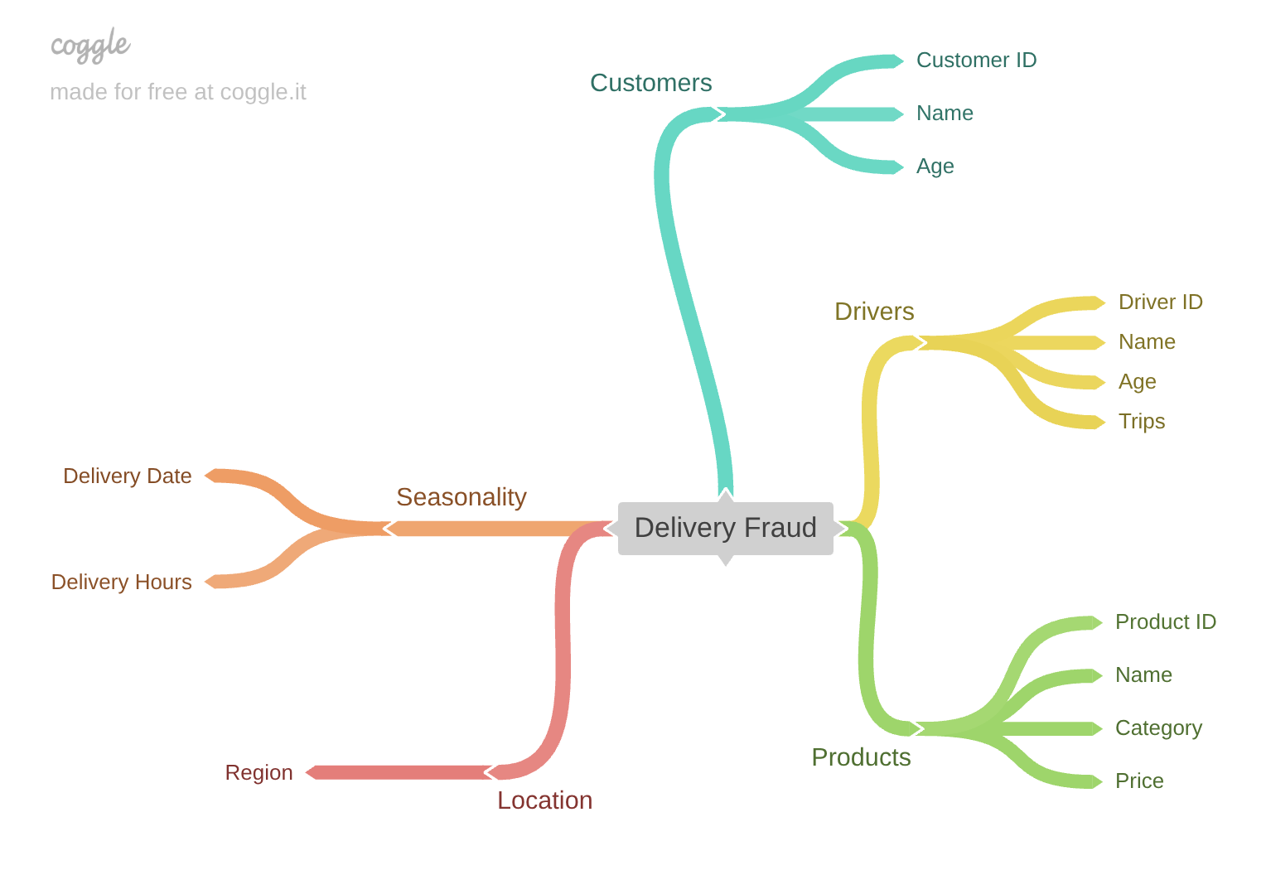
Dimensions

Slide 11
Hypotheses
To address the research questions and generate actionable insights, 12 hypothesis were tested across five key dimensions using the defined metrics.
Seasonality
H1 - Missing item and revenue loss rates increase during night deliveries.
H2 - Missing item and revenue loss rates increase during seasonal peak periods (e.g., summer and year-end).
H3 - Missing item and revenue loss rates are higher on weekends.
Location
H4 - Missing item rates differ across regions.
H5 – The average monetary loss per missing item varies by region.
Products
H6 - Electronics generate disproportionate revenue loss and missing item rate.
H7 - Missing item frequency and revenue loss are inversely related to product price.
H8 - Watches and beverages are more frequently reported missing.
Customers
H9 - Missing item and revenue loss rates differ across customer age groups.
Drivers
H10 - Drivers with multiple IDs show higher missing item and revenue loss rates.
H11 - Missing item and revenue loss rates differ across driver age groups.
H12 - Missing item and revenue loss rates increase with driver trip volume.

Slide 12


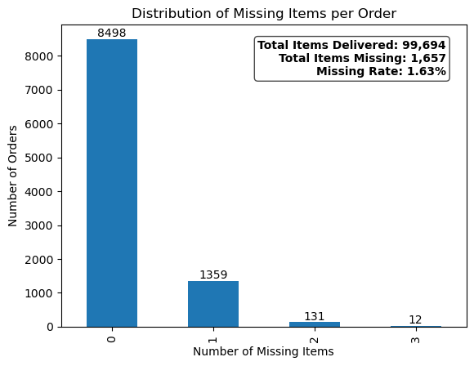
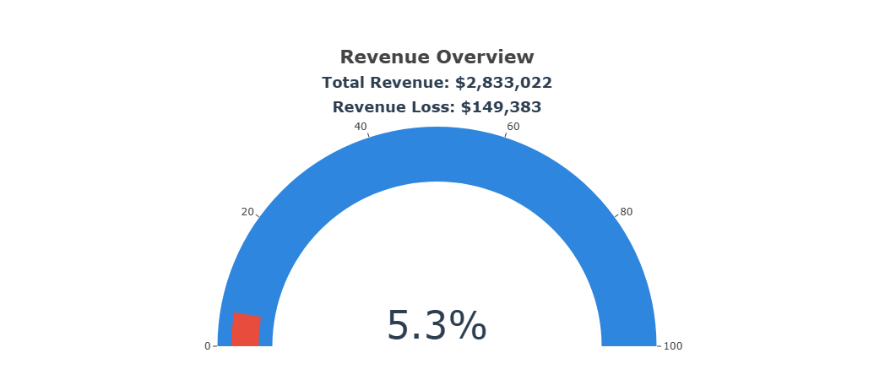
Overview (Supporting Metrics)
Total Missing Items
Total Revenue Loss

Slide 13
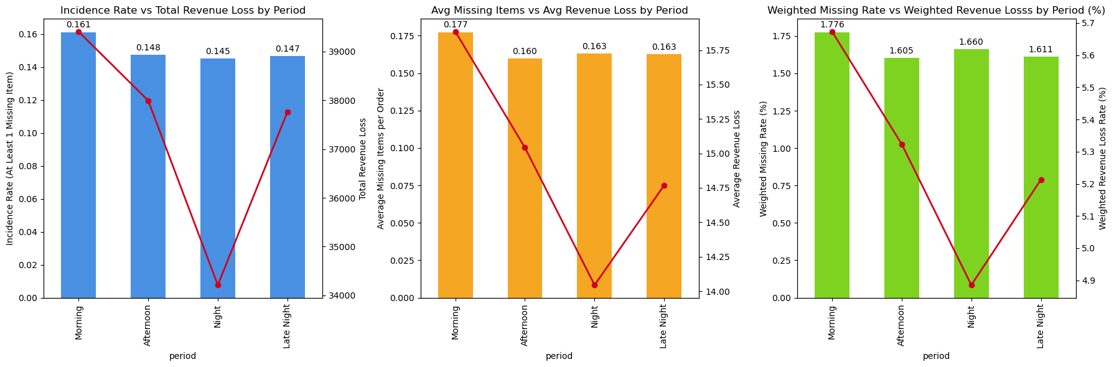
Hypotheses Validation - Seasonality
H1 - Missing item and revenue loss rates increase during night deliveries.
This hypothesis is not supported.
Morning deliveries show higher missing items and revenue loss frequency and dispersion, indicating greater operational instability and potential fraud exposure.
Highest Missing Items Incidence: Morning 16.1% Average Revenue Loss: Morning 15.88%
Highest Average Missing Items: Morning 17.7% Highest Weighted Revenue Loss Rate: Morning 5.67%
Highest Weighted Missing Items Rate: Morning 1.77%

Slide 14
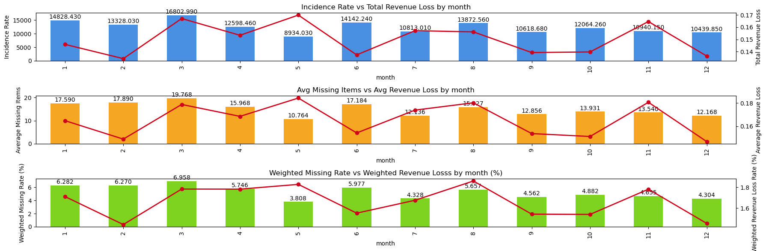
H2 - Missing item and revenue loss rates increase during seasonal peak periods (e.g., summer and year-end).
This hypothesis is not supported.
Seasonal peak periods do not significantly increase operational or financial risk.
Highest Missing Items Incidence: May 16.99% Average Revenue Loss: March 19.76%
Highest Average Missing Items: May 18.43% Highest Weighted Revenue Loss Rate: March 6.95%
Highest Weighted Missing Items Rate: August 1.86%

Slide 15
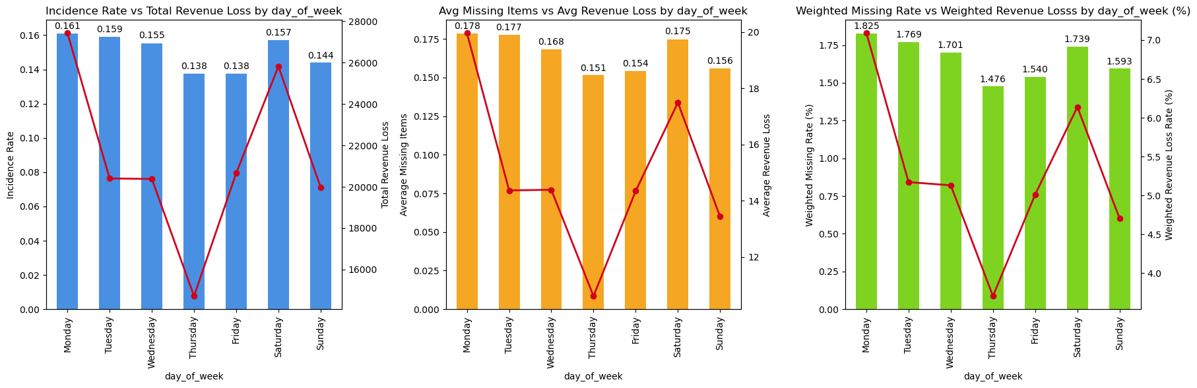
H3 - Missing item and revenue loss rates are higher on weekends.
This hypothesis is not supported.
Operational risk appears more concentrated at the beginning of the week rather than during weekends, although Saturday still represents a relevant risk window.
Highest Missing Items Incidence: Monday 16.08% Average Revenue Loss: Monday 19.96%
Highest Average Missing Items: Monday 17.83% Highest Weighted Revenue Loss Rate: Monday 7.08%
Highest Weighted Missing Items Rate: Monday 1.82%

Slide 16
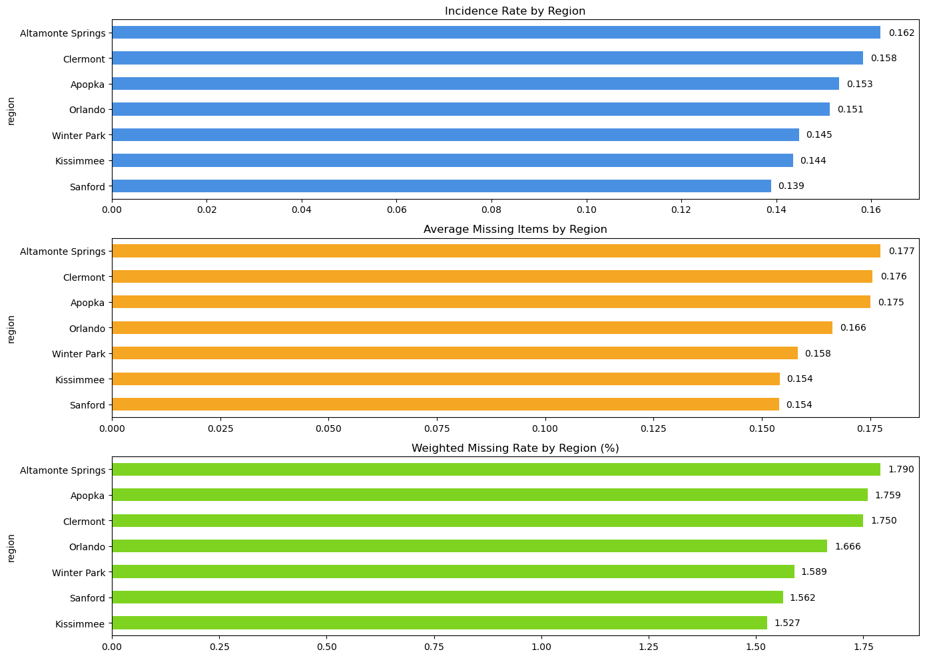
Hypotheses Validation - Location
H4 - Missing item rates differ across regions.
This hypothesis is partially supported (Weak-to-Moderate Evidence).
Regional variation exists, but differences are moderate (range: 1.53% – 1.79%). No region shows extreme or abnormal behaviour.
Highest Risk Region: Altamonte Springs
Incidence: 16.20%
Average Missing Items: 17.74%
Weighted Missing Items Rate: 1.79%
Lowest Risk Region: Kissimmee
Incidence: 14.36%
Average Missing Items: 15.41%
Weighted Missing Items Rate: 1.52%

Slide 17
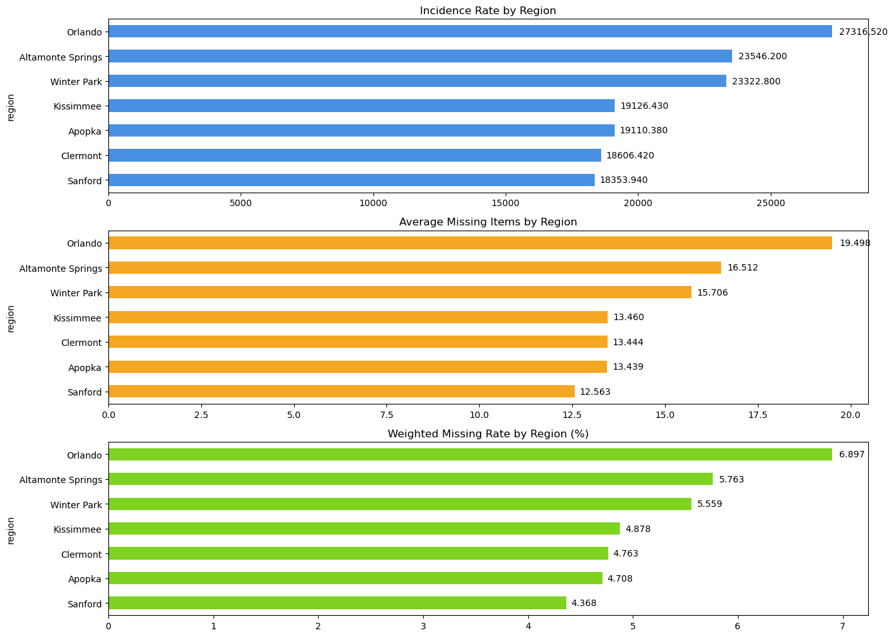
H5 - The average monetary loss per missing item varies by region.
This hypothesis is supported.
Revenue loss per missing item varies significantly by region. Orlando shows the highest financial impact about 55% higher than Sanford, indicating a higher concentration of high-value missing products.
Highest Risk Region: Orlando
Average Revenue Loss: 19.49%
Weighted Revenue Loss Rate: 6.89%
Lowest Risk Region: Sanford
Average Revenue Loss: 12.56%
Weighted Revenue Loss Rate: 4.36%

Slide 18
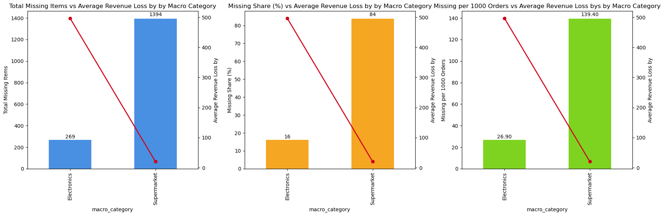
Hypotheses Validation - Products
H6 - Electronics generate disproportionate revenue loss and missing item rate.
This hypothesis is partially supported (supported for Revenue Loss, not supported for Missing Items).
Operational issues are concentrated in supermarket items, but electronics represent the largest financial risk per incident.
Supermarket items account for 83.8% of missing items.
Electronics represent only 16.2% of missing items incidents.
However, electronics generate ~5× higher total revenue loss
Electronics Revenue Loss average is $496.53 while Supermarket revenue loss average is $20.35.
Electronics missing events are 24x more financially severe Business implication.

Slide 19
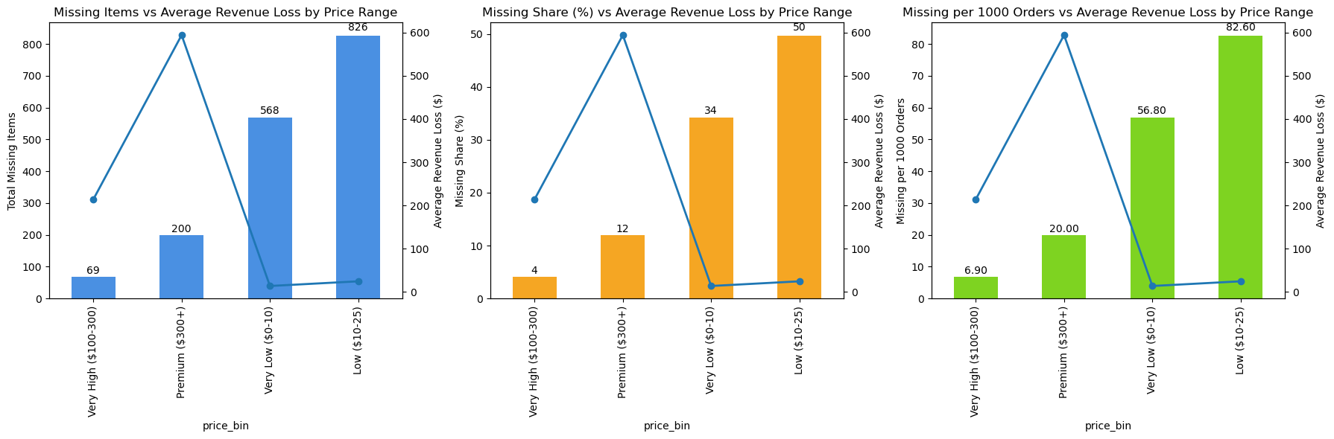
H7 - Missing item frequency and revenue loss are inversely related to product price.
This hypothesis is partially supported (not supported for Revenue Loss, supported for Missing Items).
Low-price products drive operational volume risk, while high-price products drive financial risk.
Highest missing items share rate occurs in low price ($10–25) products (50% of missing items)
Very low-price products ($0–10) also show elevated missing items share rates (34% of missing items)
Premium products generate the largest revenue loss with revenue loss average of $584.01, followed by very high products with revenue loss average of $213.98
Low price products generate the highest total loss due to order volume $20,454,5600
High-value items create higher financial exposure per incident

Slide 20
H8 - Watches and beverages are more frequently reported missing.
Items Missing by Electronics Products
Items Missing by Supermarket Products
This hypothesis is not supported.
Missing item patterns appear to be driven more by high-demand products rather than specific product types such as watches or beverages.
Electronics missing items are mainly:
Earbuds
Computer accessories
Consumer electronics devices
Supermarket missing items are mainly:
Meat and protein products
Dairy items
Pantry staples
Product Name
Bose QuietComfort Earbuds
Logitech Mouse
Dell XPS 13
Beats Studio Pro Headphone
Nest Thermostat
Dyson V11 Vacuum
JBL Flip Speaker
HP Envy Printer
Roku Ultra Streaming Device
Panasonic Lumix Camera
# of Products
14
14
12
11
11
10
10
10
10
9
Product Name
Chicken Breast
Ground Coffee
Cheddar Cheese
Frozen Shrimp
Uncured Bacon
Peanut Butter
Canned Tuna
Rice Cakes
Turkey Burgers
Broccoli
# of Products
19
19
18
17
17
17
17
16
16
15

Slide 21
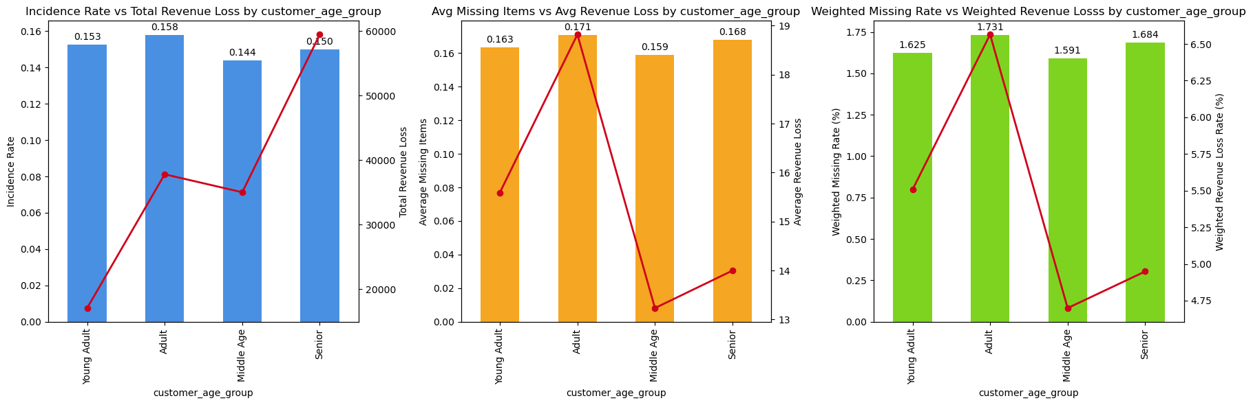
Hypotheses Validation - Customers
H9 - Missing item and revenue loss rates differ across customer age groups.
This hypothesis is weakly/partially supported.
Customer age segments impact the financial consequences of missing items, however, it has minimal impact on missing items rate, suggesting that operational issues are evenly distributed across customer segments.
Weighted missing items rates range from 1.59% to 1.73%
Adults show the highest rate
Middle-aged customers show the lowest rate
Adults show the highest weighted revenue loss rate (6.56%)
Middle-aged customers show the lowest loss rate (4.70%)
Seniors generate the highest total loss due to order volume $ 59,475,2200

Slide 22
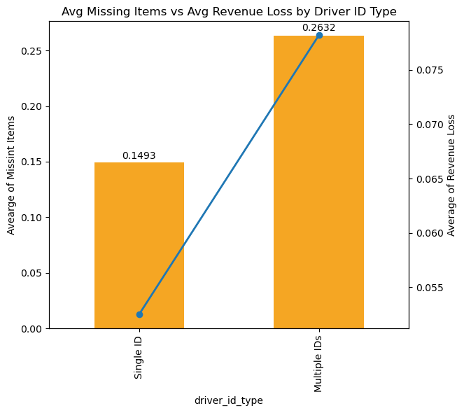
Hypotheses Validation - Drivers
H10 - Drivers with multiple IDs show higher missing item and revenue loss rates.
This hypothesis is supported (but with limited evidence.).
Drivers associated with multiple IDs exhibit higher missing item rates and higher revenue loss rates compared to drivers operating under a single ID.
Average missing items rate is 76% higher among multi-ID drivers
Average Missing Items Rate: 26.32% vs 14.93%
Average revenue loss rate is 49% higher among multi-ID drivers
Average Revenue Loss Rate: 7.82% vs 5.25%
Indicates potential operational risk
Multi-ID group represents very small sample size
Orders 9924 vs 76
The statistical reliability of the comparison is limited
Further investigation with a larger sample is necessary

Slide 23
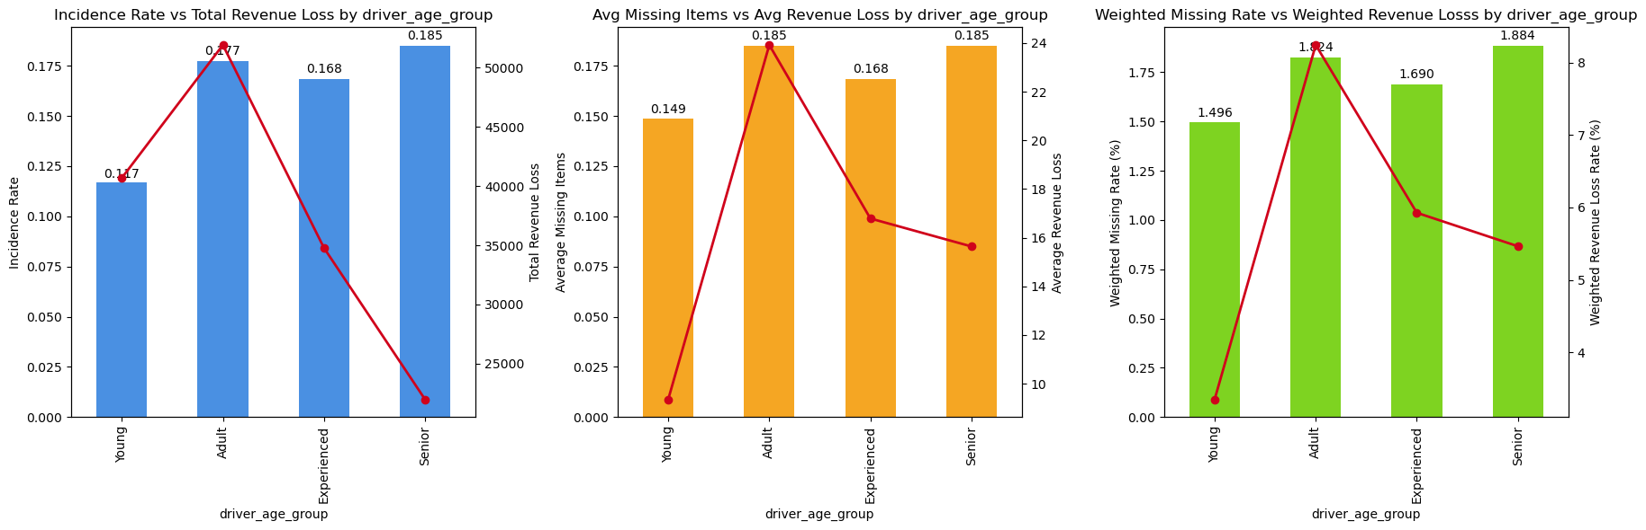
H11 - Missing item and revenue loss rates differ across driver age groups.
This hypothesis is supported.
Drivers age may influence missing rates slightly, but differences remain relatively small, however, revenue loss rates show stronger variation across groups, potentially reflecting differences in workload, route complexity, or operational behavior.
Weighted missing items rates range from 1.88% to 1.49%
Senior show the highest rate
Younger drivers show the lowest rate
Weighted revenue loss rates range from 8.24% to 3.35%
Adults show the highest rate
Younger drivers show the lowest rate

Slide 24
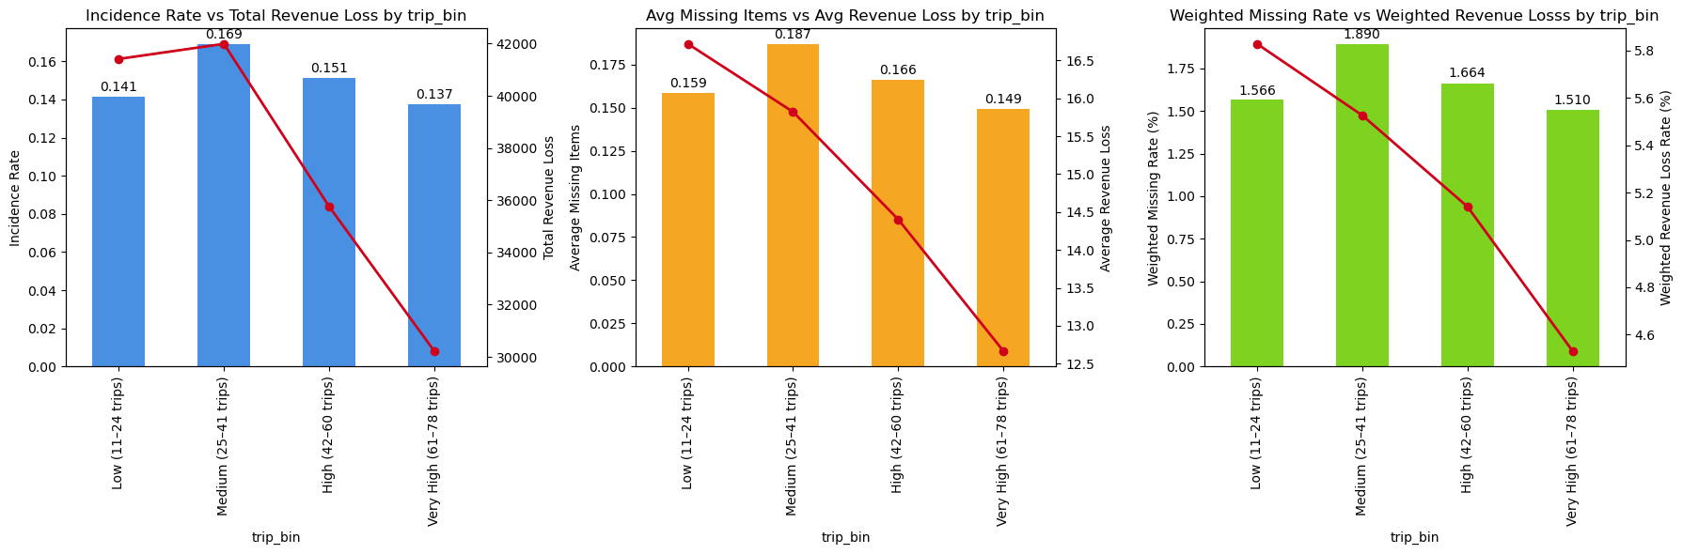
H12 - Missing item and revenue loss rates increase with driver trip volume.
This hypothesis is not supported.
Medium-volume drivers show the highest missing item rates, while high-volume drivers show the lowest — suggesting experience effect, where highly active drivers develop operational familiarity that reduces fulfilment errors.
Highest weighted missing items rate occurs in medium (25-41) trips (1.89%)
Weighted revenue loss rate decreases as trip volume increases (Low 5.82% - Very High 4.53%)

Slide 25
Additional Analysis (Operational Monitoring)
The following analysis highlights the top 15 customers and drivers with highest number of:
Missing Items reported
Revenue loss generated
While not used for hypothesis validation, this analysis supports:
Fraud alert identification
Operational monitoring
Investigation prioritization

Slide 26
Top 15 Customers with highest number of items missing reported and revenue loss generated.
Customer Id | Customer Name | Customer Age | # of Missing Items by Customers | Revenue Loss by Customers
WCID5820 | Edward Henry | 73 | 9 | 101.18
WCID5685 | Shelley Gould | 85 | 7 | 1467.61
WCID5857 | Douglas Roth | 81 | 7 | 88.16
WCID5165 | David Mccoy | 59 | 6 | 1520.85
WCID5593 | Victor Gonzalez | 86 | 6 | 250.13
WCID5007 | Timothy Daniel | 18 | 6 | 245.49
WCID5339 | Jerry Mullen | 64 | 6 | 55.43
WCID6164 | Karen Moore | 47 | 6 | 64.43
WCID5978 | Raymond Chavez | 30 | 6 | 49.63
WCID6096 | Holly Stewart | 76 | 5 | 38.76
WCID5046 | James Hopkins | 38 | 5 | 830.19
WCID5817 | Angela Bradley | 67 | 5 | 72.53
WCID5652 | Carla Knox | 23 | 5 | 689.41
WCID5594 | Robert Odonnell | 45 | 5 | 42.75
WCID5511 | David Hicks | 89 | 5 | 245.75
Customer Id | Customer Name | Customer Age | # of Missing Items by Customers | Revenue Loss by Customers
WCID5923 | Kenneth Brown | 19 | 4 | 1657.5
WCID5638 | Angela Brock | 52 | 3 | 1594.95
WCID5164 | Keith Jones | 27 | 2 | 1571.26
WCID5938 | Stephen Cook | 87 | 3 | 1546.24
WCID5165 | David Mccoy | 59 | 6 | 1520.85
WCID5685 | Shelley Gould | 85 | 7 | 1467.61
WCID5653 | Matthew Roberts | 66 | 4 | 1305.11
WCID5964 | John Scott | 35 | 2 | 1276.4
WCID6128 | Robert Wilson | 23 | 3 | 1189.16
WCID5180 | William Owens | 65 | 3 | 1122.08
WCID5733 | Joseph Perry | 61 | 3 | 1093.01
WCID5228 | Mr. Gregory Luna | 25 | 5 | 1088.32
WCID5860 | Robert Sanchez | 21 | 5 | 1058.11
WCID5810 | Thomas Wallace | 65 | 3 | 979.65
WCID5333 | Lisa Martinez | 41 | 3 | 923.67
Ordered by # of Missing Items
Ordered by Revenue Loss

Slide 27
Top 15 Drivers with highest number of items missing reported and revenue loss generated.
Driver Id | Driver Name | Driver Age | Driver Trips | # of Missing Items by Drivers | Revenue Loss by Drivers
WDID09882 | Angela Young | 18 | 75 | 6 | 1084.34
WDID09883 | Charles Rios DVM | 18 | 62 | 6 | 570.28
WDID09884 | James Winters | 18 | 22 | 6 | 372.38
WDID09877 | James White | 18 | 14 | 6 | 95.6
WDID09878 | Roger Green | 18 | 22 | 6 | 482.64
WDID09879 | Shane Palmer | 18 | 35 | 6 | 600.96
WDID09880 | Brittany Gordon | 18 | 36 | 6 | 797.26
WDID09876 | Jordan Daniel | 18 | 53 | 6 | 46.95
WDID09875 | Stephen Randolph | 18 | 64 | 6 | 884.81
WDID09874 | Billy Lawson | 18 | 37 | 6 | 1310.38
WDID09873 | Pamela Moore | 18 | 64 | 6 | 58.03
WDID09881 | Tracey Watkins | 18 | 26 | 6 | 759.78
WDID09891 | Justin Parsons | 18 | 16 | 5 | 60.18
WDID09890 | Cynthia Owens | 18 | 67 | 5 | 916.8
WDID09893 | Mrs. Valerie Schwartz MD | 18 | 77 | 5 | 371.49
Driver Id | Driver Name | Driver Age | Driver Trips | # of Missing by Drivers | Revenue Loss by Drivers
WDID10442 | Marc Waters | 27 | 12 | 5 | 2044.08
WDID10464 | Paul Leach | 30 | 57 | 4 | 2034.34
WDID10476 | Scott Carter | 51 | 12 | 4 | 1889.86
WDID10422 | Patrick Hall | 26 | 27 | 5 | 1869.39
WDID10387 | Dalton Rogers | 24 | 27 | 5 | 1731.45
WDID10447 | Patricia Vance | 18 | 40 | 5 | 1683.03
WDID10418 | Kelsey Mitchell | 26 | 18 | 5 | 1681.77
WDID10420 | Heather King | 26 | 31 | 5 | 1651.38
WDID10466 | Alison Knight | 29 | 13 | 4 | 1578.61
WDID10468 | Joan Melton | 31 | 40 | 4 | 1486.8
WDID10726 | Lindsey Johnson | 46 | 34 | 3 | 1423.54
WDID10734 | Michael Zimmerman | 65 | 69 | 3 | 1374.31
WDID10469 | Leslie Powell | 46 | 47 | 4 | 1363.22
WDID10423 | Robert Wright | 26 | 63 | 5 | 1347.02
WDID10641 | Chelsey Willis | 51 | 63 | 3 | 1344.99
Ordered by # of Missing Items
Ordered by Revenue Loss

Slide 28
Integrated Analytical Narrative (H1-H12)
Objective
Identify whether missing items are driven by operations, behavior, or fraud patterns.
Operations Patterns
No clear operational risk pattern
→ Missing items are not driven by time, seasonality, or region
Morning and early week show slightly higher incidence
→ Indicates possible operational variability, not structural risk
Regional incident frequency impact is limited but financial impact varies significantly
→ Orlando shows higher financial impact, but no strong geographic concentration concerning number of items missing
Missing items appear to be operational noise rather than systematic risk patterns
Product-Level Risk
Missing items are concentrated in high-volume categories
→ Supermarket products account for 80%+ of incidents
Financial impact driven by high-value items
→ Electronics have lower frequency but higher revenue loss
Different drivers for frequency vs. impact
→ Low-price items → more frequent
→ High-price items → higher financial exposure
Missing items are driven by operational volume, while financial risk is driven by product value

Slide 29
Customers behavior
No strong demographic pattern
→ Missing item rates are consistent across age groups
Higher financial impact among adults
→ Likely driven by larger baskets or higher-value purchases
Limited influence on missing item occurrence
→ Issues affect customers broadly, not specific segments
Customer behavior is not a primary driver of missing item incidents
Driver Behavior and Operational Execution
Higher risk linked to multi-ID drivers
→ Associated with higher missing rates and revenue loss (interpret with caution)
Moderate variation across driver age groups
→ Adult and senior drivers show slightly higher incidence
→ Younger drivers show lower rates
Experience reduces operational risk
→ High-volume drivers have fewer missing items and lower losses
Driver experience improves performance; while multi-ID use signals risk
Overall Interpretation
Missing items are primarily operational
→ No strong evidence of systematic fraud patterns
Incidents driven by high-volume operations (low-value items)
→ Concentrated in frequent, routine processes
Financial impact driven by high-value products
→ Low frequency, but high exposure (e.g., electronics)
Missing items reflect a mix of operational inefficiencies (volume-driven) and financial exposure (value-driven)

Slide 30
Hypotheses Key Findings
1. Operational Volume Drives Incidents
• Low price supermarket items dominate missing cases → High volume → more operational errors
3. Financial Impact Outweighs Incident Frequency Across Regions and Customers
• Incident frequency impact is limited
→ Missing items not concentrated in specific locations or customer segments
• Financial impact varies significantly
→ Orlando (region) and adults (customer) generate higher revenue loss per incident
2. Electronics Drive Financial Risk
• Fewer incidents, but highest revenue loss → Higher value → higher revenue loss

Slide 31
4. Driver Experience Improve Operational Performance
• Drivers with higher trip volume → fewer errors → High experience → more delivery accuracy and efficiency → fewer missing items and revenue loss
6. Certain Operational Time Windows Show Higher Risk Variability
• Higher risk in mornings /early week → Possible factors are higher operational workload, shift transitions, or inventory replenishment cycles
5. Multiple Driver IDs = Risk Signal
• Higher missing rates and revenue loss observed
• Small sample size
→ although the sample size remains small, the pattern may indicate potential operational irregularities or identity management issues within the driver system

Slide 32
4.Fraud Risk Score Framework
The framework is divided into three parts.
Fraud Risk Score Framework Methodology
Most Critical Segments
Fraud Risk Score Key Business Findings

Slide 33
Fraud Risk Score Framework Methodology
A Fraud Risk Score will combine key risk indicators to assess order risk, enabling proactive monitoring and investigation prioritization.
Objective
Select key risk variables derived from the EDA
Normalize and standardize relevant metrics
Combine weighted indicators into a composite risk score
Assign relative risk levels to delivery orders
The score will not represent confirmed fraud probability, but rather a relative risk assessment tool to support preventive decision-making.
Component | Meaning | Weight
Incidence rate | Frequency of incidents | 15%
Weighted missing | Operational severity | 15%
Average revenue loss | Financial intensity | 35%
Weighted revenue loss | Financial efficiency loss | 25%
Order volume | Reliability od sample | 10%
Score Risk Level | Classification
0-25 | Los Risk
25-50 | Moderate Risk
50-75 | High Risk
75-100 | Critical Risk

Slide 34
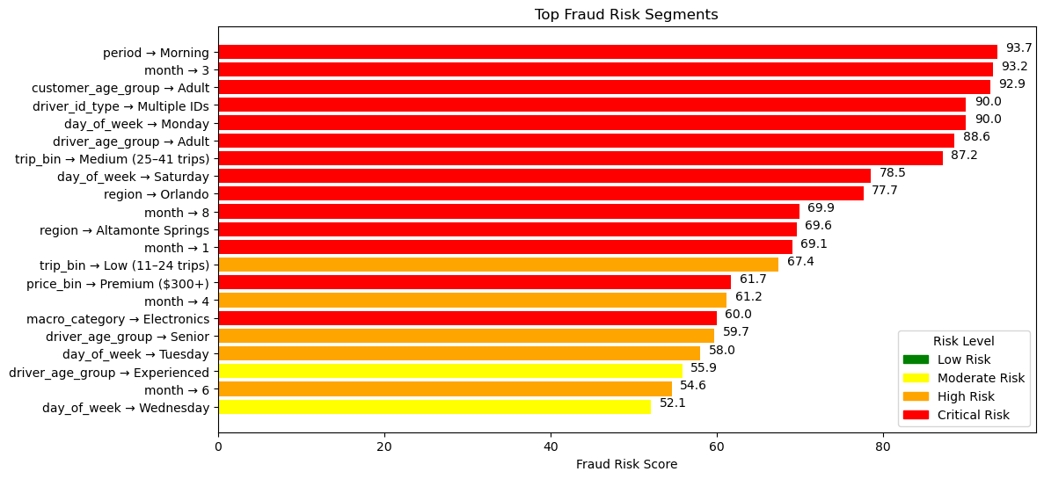
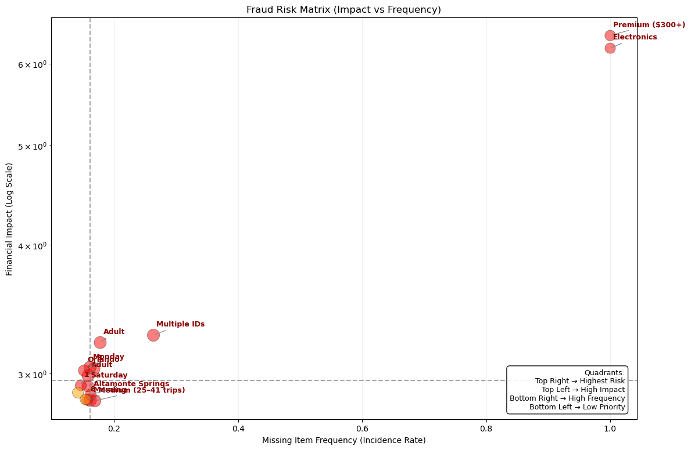
Most Critical Segments
Top Fraud Risk Segments: Fraud risk is concentrated in specific operational periods, driver profiles, and high-value products.
Fraud Risk Matrix: High-risk segments cluster in the top-right quadrant, combining high frequency and high financial impact.

Slide 35
Fraud Risk Score Key Business Findings
1. High-Value Products Drive Risk
• Electronics & Premium ($300+) → Critical Risk → High financial exposure
2. Operational Timing Matters
• Morning, specific months, and weekdays show higher risk
3. Driver & Customer Segments
• Medium trip drivers → higher risk • Adult/Senior groups → elevated patterns
4. Volume ≠ Financial Risk
• Low volume + high value → highest risk
Final Insight
Risk is driven by 3 factors:
High-value products (financial)
Operational timing (process)
Driver behavior (execution)

Slide 36
5.Final Recommendations
Recommendations based on exploratory data analysis
Recommendations based on Risk level

Slide 37
Recommendations based on EDA
Protect High-Value Orders
• Enforce delivery confirmation (photo + verification)
→ Photo of the recipient holding the package
→ PIN sent via SMS to the buyer 30 minutes before arrival
→ Recipient ID check
• Use tamper-proof packaging
→ Seals applied across the package
3. Improve High-Volume Operations
• Add picking validation
→ Mandatory barcode validation at every picking stage to eliminate item errors.
• User automated order checks
→ Automated systems to cross-verify order contents against shipping manifests.
2. Strengthen Driver Identity Control
• Flag multiple ID accounts
→ Automatic flagging and manual audit if 2+ driver names share the same Device ID (IMEI) or Bank Account.
• Implement identity verification
→ Random 3D Selfies to prevent account sharing and "Ghost Drivers.

Slide 38
Recommendations based on EDA
4. Develop Driver Performance Strategy
• Train mid-experience drivers
→ Focused coaching for established drivers to reduce delivery errors.
• Incentivize delivery accuracy
→ Tiered bonuses for high verification compliance and positive customer ratings.
5. Implement Risk Monitoring System
• Track high-risk segments in real time
→ Instant notifications when orders enter designated "Red Flag" sectors.
• Monitor products, drivers, and time windows
→ Auditing the overlap of high-value goods, new drivers, and morning/early week shift windows.

Slide 39
Recommendations based on Risk Level
Critical Risk Actions: • Enforce delivery confirmation (photo + PIN +Verification)
• Use tamper-proof packaging for high-value items • Flag multiple drivers ID accounts
• Track high-risk segments in real time
High Risk Actions: • Add picking validation • User automated order checks Moderate Risk Actions: • Standard monitoring • Track for pattern escalation Low Risk Actions: • No immediate action required

Slide 40
6.Project Summary

Slide 41
Problem: Missing items → financial loss & customer dissatisfaction
Insight: Issue is operational, not fraud-driven
Risk Drivers:
High-value products
Operational timing
Driver behavior
Impact:
Volume drives errors
Value drives losses
Actions:
Protect high-value orders
Improve operations
Monitor drivers
Use risk framework

Slide 42
7.Fraud Risk Score Simulator
A fraud risk simulator was developed using the Fraud Risk Framework scores.
The tool estimates the risk level of a delivery based on operational, driver, customer, and product characteristics by aggregating segment-level risk scores.
Link: https://delivery-fraud-risk-score-simulator-walmart.streamlit.app/

Slide 43
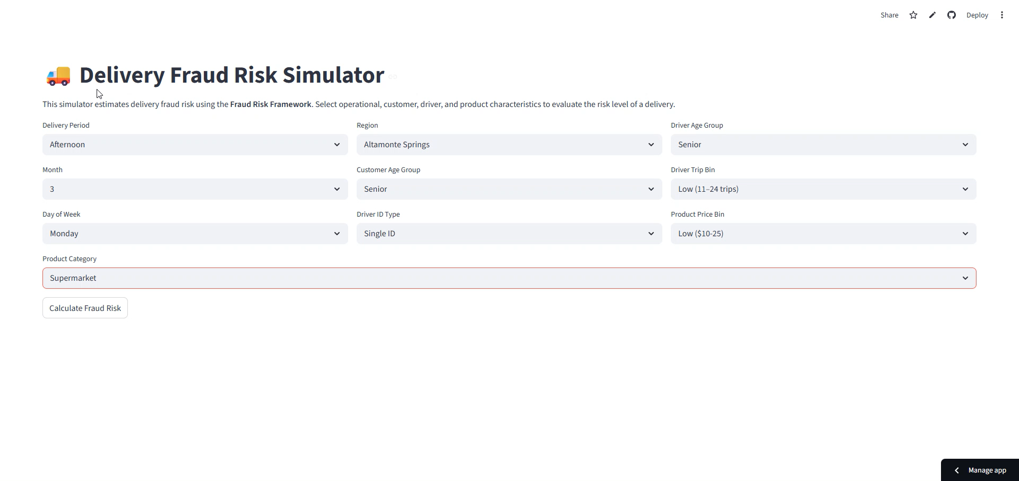
Fraud Risk Score Simulator – How to operate

Slide 44
8.Interactive Fraud Analysis & Risk Dashboard
Identify high-risk deliveries before escalation
Prioritize operational controls based on impact
Monitor fraud risk patterns across key dimensions
Link: https://github.com/IgorQueiroz23031988/Walmart-Delivery-Fraud-Detection/tree/main/interactive_dashboard

Slide 45
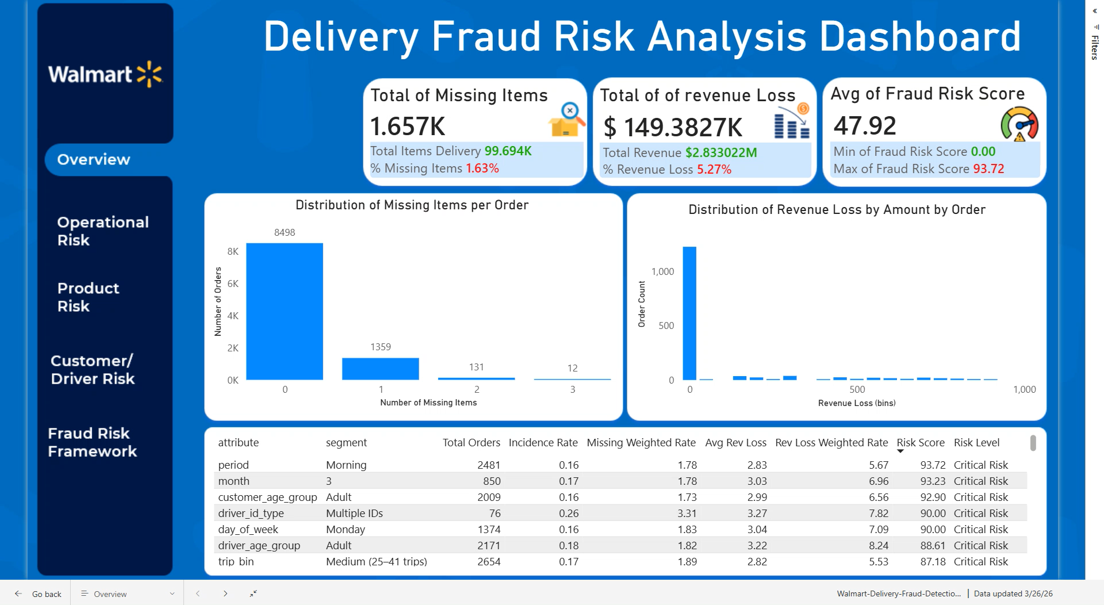
Interactive Dashboard

Slide 46
Thank You
For complete access to all project and resources, please visit: https://github.com/IgorQueiroz23031988/Walmart-Delivery-Fraud-Detection/tree/main

